Slide 1






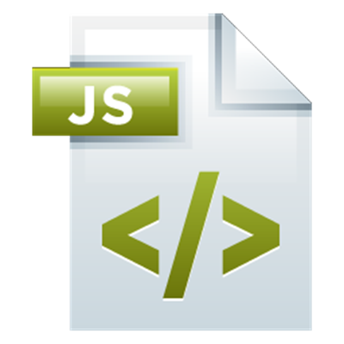
Advanced Node.js
File System, Streams, Events, Debugging, Deployment
Express.js Development
SoftUni Team
Technical Trainers
Software University
http://softuni.bg

Slide 2

Table of Contents
Node.js behind the scenes
Working with utilities
File System, Crypto, Cluster, ZLib
Streams
Events
Debugging Node.js applications
Deployment

Slide 3
Have a Question?
sli.do #express-js

Slide 4
Node.js Behind The Scenes
Single or multi-threaded?

Slide 5
Node.js Behind The Scenes
Evented I/O
Don’t call us, we’ll call you
Non-blocking
Asynchronous
Event loop
Worker threads and the V8 engine
The event loop is single-threaded, but underneath relies on an internal pool of C++ threads

Slide 6
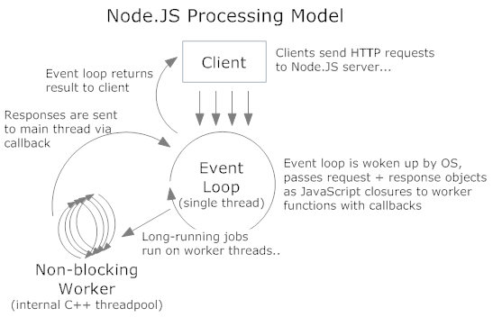
Node.js Behind The Scenes
Node.js processing model

Slide 7
Working With Utilities
Async And Sync Methods

Slide 8
Working with the file system
The fs module
Two ways to tackle working with fs:
Synchronous
Asynchronous (the node.js way)
Synchronous
var fs = require("fs");
fs.mkdirSync(path, [mode]);
fs.renameSync(oldPath, newPath);
fs.writeFileSync(filename, data, [options]);

Slide 9
Working with the file system
Asynchronous
Official documentation
http://nodejs.org/api/fs.html
fs.mkdir(path, [mode], callback);
fs.rename(oldPath, newPath, callback);
fs.writeFile(
filename, data, [options], callback);

Slide 10
Working with crypto
The crypto module
Password hasher
let crypto = require("crypto");
let crypto = require('crypto')
module.exports = {
generateSalt: () => {
return crypto.randomBytes(128).toString('base64');
},
generateHashedPassword: function (salt, pwd) {
let hmac = crypto.createHmac('sha1', salt);
return hmac.update(pwd).digest('hex');
}
};

Slide 11
Working with cluster
The cluster module
https://www.sitepoint.com/how-to-create-a-node-js-cluster-for-speeding-up-your-apps/
let cluster = require('cluster')
let http = require('http')
let cpus = require('os').cpus().length
if (cluster.isMaster) {
for (let i = 0; i < cpus; i++) {
cluster.fork()
}
} else {
// start http server
}

Slide 12
Streams
Streams, buffers and chunks

Slide 13
Streams
Buffers
JS is unicode friendly, but not the best when it comes to binary data
Can be easily transformed into JS object by setting an encoding in the buffer’s toString() method
let fs = require('fs')
fs.readFile('index.js', 'utf8', (err, data) => {
console.log(data)
})

Slide 14
Streams
Types
Readable – can only be read (process.stdin)
Writeable – can only be written to (process.stdout)
Duplex – both Readable and Writeable (tcp sockets)
Transform – Duplex streams where the output is computed from the input (zlib, crypto)

Slide 15
Streams
Readable
let fs = require('fs')
let readStream = fs.createReadStream('index.js')
let result = [] // try with ''
readStream.on('data', (data) => { result.push(data) })
readStream.on('end', () => console.log(result))

Slide 16
Streams
HTTP Request is a readable stream
let http = require('http')
let query = require('querystring')
http
.createServer((req, res) => {
if (req.method === 'POST') {
let body = ''
req.on('data', (data) => { body += data })
req.on('end', () => {
let parsedBody = query.parse(body)
})
}
})
.listen(1234)

Slide 17
Streams
Writeable
HTTP Response is a writeable stream
const fs = require('fs')
let readStream = fs.createReadStream('index.js')
let writeStream = fs.createWriteStream('index.copy.js')
readStream.on('data', (data) => writeStream.write(data))
readStream.on('end', () => console.log('ended'))

Slide 18
Streams
Pipe method
Allows fast read/write operations
Reads chunks one by one and transfer them
Like data/end but easier to write and use
const fs = require('fs')
let readStream = fs.createReadStream('index.js')
let writeStream = fs.createWriteStream('index.copy.js')
readStream.pipe(writeStream)

Slide 19
Streams
Duplex stream
Implements both the Readable and Writeable interfaces
Example - a TCP socket
Transform stream
A special kind of duplex stream where the output is a transformed version of the input
http://codewinds.com/blog/2013-08-20-nodejs-transform-streams.html

Slide 20
Streams
Transforms with Gzip
More information: https://nodejs.org/dist/latest-v6.x/docs/api/zlib.html#zlib_compressing_http_requests_and_responses
const fs = require('fs')
const zlib = require('zlib')
let readStream = fs.createReadStream('index.js')
let writeStream = fs.createWriteStream('index.js.gz')
let gzip = zlib.createGzip()
readStream.pipe(gzip).pipe(writeStream)

Slide 21
File Upload
Using formidable to upload files (do not forget the enctype)
let form = new formidable.IncomingForm()
form.parse(req, (err, fields, files) => {
if (err) {
console.log(err)
return
}
console.log(fields) // examine and use
console.log(files) // examine and use with fs.rename for example
})

Slide 22
Events
Emit Your Data

Slide 23
Events
Huge application in node.js applications
Many objects in node.js emit events, i.e. are EventEmitters. Examples are fs, net, zlib, etc.
Basically an implementation of the publish/subscribe pattern
const events = require('events')
let emitter = new events.EventEmitter()
emitter.on('someEvent', (data) => {
console.log(data)
})
emitter.emit('someEvent', 'eventData')

Slide 24
Debugging
Inspectors And Watchers

Slide 25
Debugging & watching in Node.js
Debugging in Node.js
The V8 debug protocol
JSON based protocol
IDEs with a debugger
Webstorm
Visual Studio
Node-inspector (not working with latest version)
Watching with Nodemon

Slide 26
Deployment
Use The Cloud

Slide 27
App Deployment in Cloud
Register in http://heroku.com
Install from https://toolbelt.heroku.com/
Heroku Toolbelt
Gives you "heroku" command
Use "node --version" and "npm --version"
And put them in "engines" – "package.json"
Add "Procfile" to the project
Write "web: node {file}.js"

Slide 28
App Deployment in Cloud
Change port to process.env.PORT
You can configure it for every environment
Create database in MongoDb Cloud
MongoLab for example
Create users too
Get the connection string
Set the MongoDb connection
You can configure it for every environment

Slide 29
App Deployment in Cloud
Set local "NODE_ENV"
Initialize new git repository, add files, commit
Login to heroku with "heroku login"
Create app with "heroku create {name}"
Run "heroku git:remote -a {name}"
Configure environment with "heroku config:set NODE_ENV={env}"
Deploy with "git push heroku master"
Use "heroku logs" and "heroku open" for help

Slide 30
App Deployment in Cloud
If troubles:
Try to add the public keys - "heroku keys:add"
If you do not have public key – "ssh-keygen"
Check out keys with "heroku keys"
Try to clear them first with "heroku keys:clear"
Try copying the keys into git repository
Try the same procedure through git bash

Slide 31








JavaScript Web – Express.js Fundamentals
https://softuni.bg/trainings/1434/node-js-development-september-2016

Slide 32

License
This course (slides, examples, demos, videos, homework, etc.) is licensed under the "Creative Commons Attribution-NonCommercial-ShareAlike 4.0 International" license
Attribution: this work may contain portions from
"End-to-end JavaScript Applications" course by Telerik Academy under CC-BY-NC-SA license

Slide 33





Free Trainings @ Software University
Software University Foundation – softuni.org
Software University – High-Quality Education, Profession and Job for Software Developers
softuni.bg
Software University @ Facebook
facebook.com/SoftwareUniversity
Software University @ YouTube
youtube.com/SoftwareUniversity
Software University Forums – forum.softuni.bg

